Slide 1
Intro to the Grant Writing Enhancement Program (GEP)
Welcome!
Rachel McGinnis – ORSP Director

Slide 3
Grant Writing Enhancement Program Goals
MAIN OBJECTIVE: Learn how to be a grant writer and successfully submit a proposal
Strengthen the campus culture by highlighting the opportunities and rewards for engagement in sponsored programs
Grow grant writing at MTSU
Increase the number of externally funded projects

Slide 4
Course Description
Three-year long program includes one-hour monthly meetings covering a variety of topics:
ORSP Resources
Finding Funding Opportunities
Grant Timeline and Template Preparation
Proposal Basics
Creating a Budget
Collaboration/Time Management
Final proposal

Slide 5
Year 1
Attend GEP Workshops held by ORSP
Complete assignments and come prepared for each workshop
Successfully submit a grant proposal

Slide 7
Years 2 & 3
Meet with your mentor for one-on-one meetings
Meet with cohort for monthly group check-in meetings and workshops
Provide Feedback for current and future programming

Slide 8
Time Commitment
Participants should plan to spend, on average, a few hours a week on GEP commitments and grant-writing
Attendance at GEP Workshops is strongly encouraged
Frequent communication with mentor and cohort members
Optional – ORSP training sessions, Raiders Research Series Presentations. Details can be found on our website on the Workshops & Training tab

Slide 9
Learning Objectives
Become familiar with grant opportunity search services to identify possible funding sources.
Learn about ORSP resources
Outline and complete the proposal narrative.
Design proposal consistent with the funder’s required objectives.
Project and prepare a budget of the project.
Produce and submit a competitive grant proposal.

Slide 10
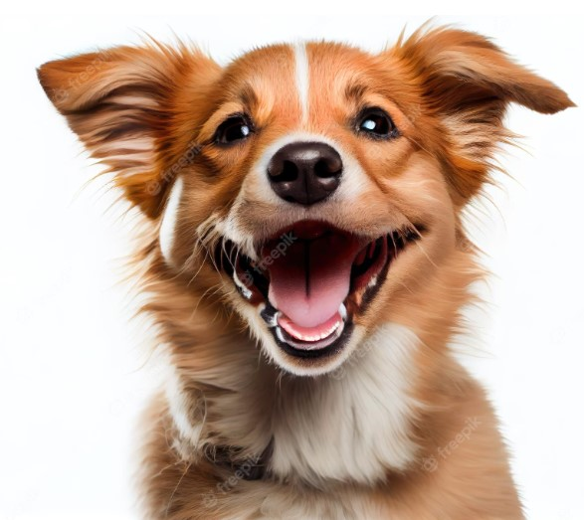
Join Today!
Registration is open! Visit the ORSP website to enroll to be a part of the Grant Writing Enhancement Program.
Contact us if you have any questions:
ORSP Director : Rachel McGinnis at Rachel.McGinnis@mtsu.edu
ORSP Program Manager: Katie Medrano at Katie.Medrano@mtsu.edu
External Grant Coordinator: Julie Darbonne at Julie.Darbonne@mtsu.edu

